Slide 1



The Chain
Automating Revit family QA tasks

Slide 2
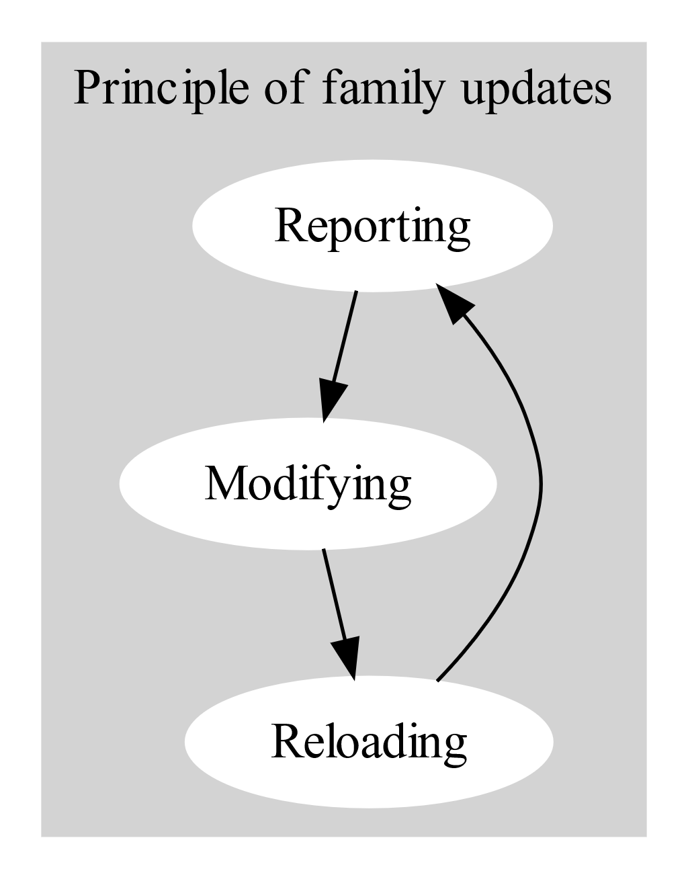
Principles
Comprises of 3 modules
Reporting family properties
Identify issues
Modifying
Addressing the issues
Reloading
Propagating fixes through out any nested families

Slide 3
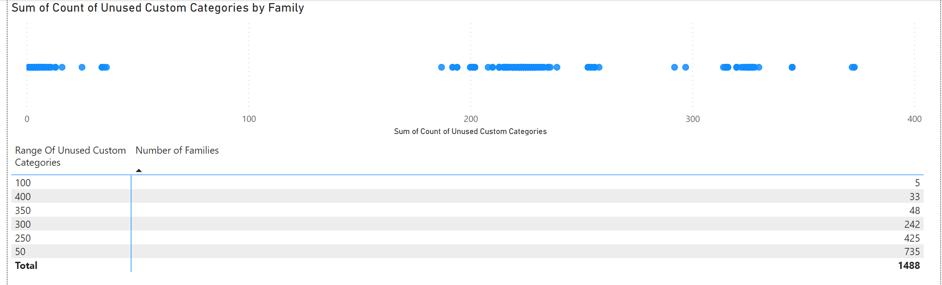
Reporting
Nesting structure
Shared parameters
Categories
Line patterns
Warnings

Slide 4
Modifying
Purge unused (using Autodesk eTransmit)
Delete unused categories
Delete unused line patterns
Rename families
On file server: family and catalogue file
In Family: any nested family
Planned:
Change family category (whilst maintaining custom sub-categories)
Rename custom categories
Rename line patterns

Slide 5
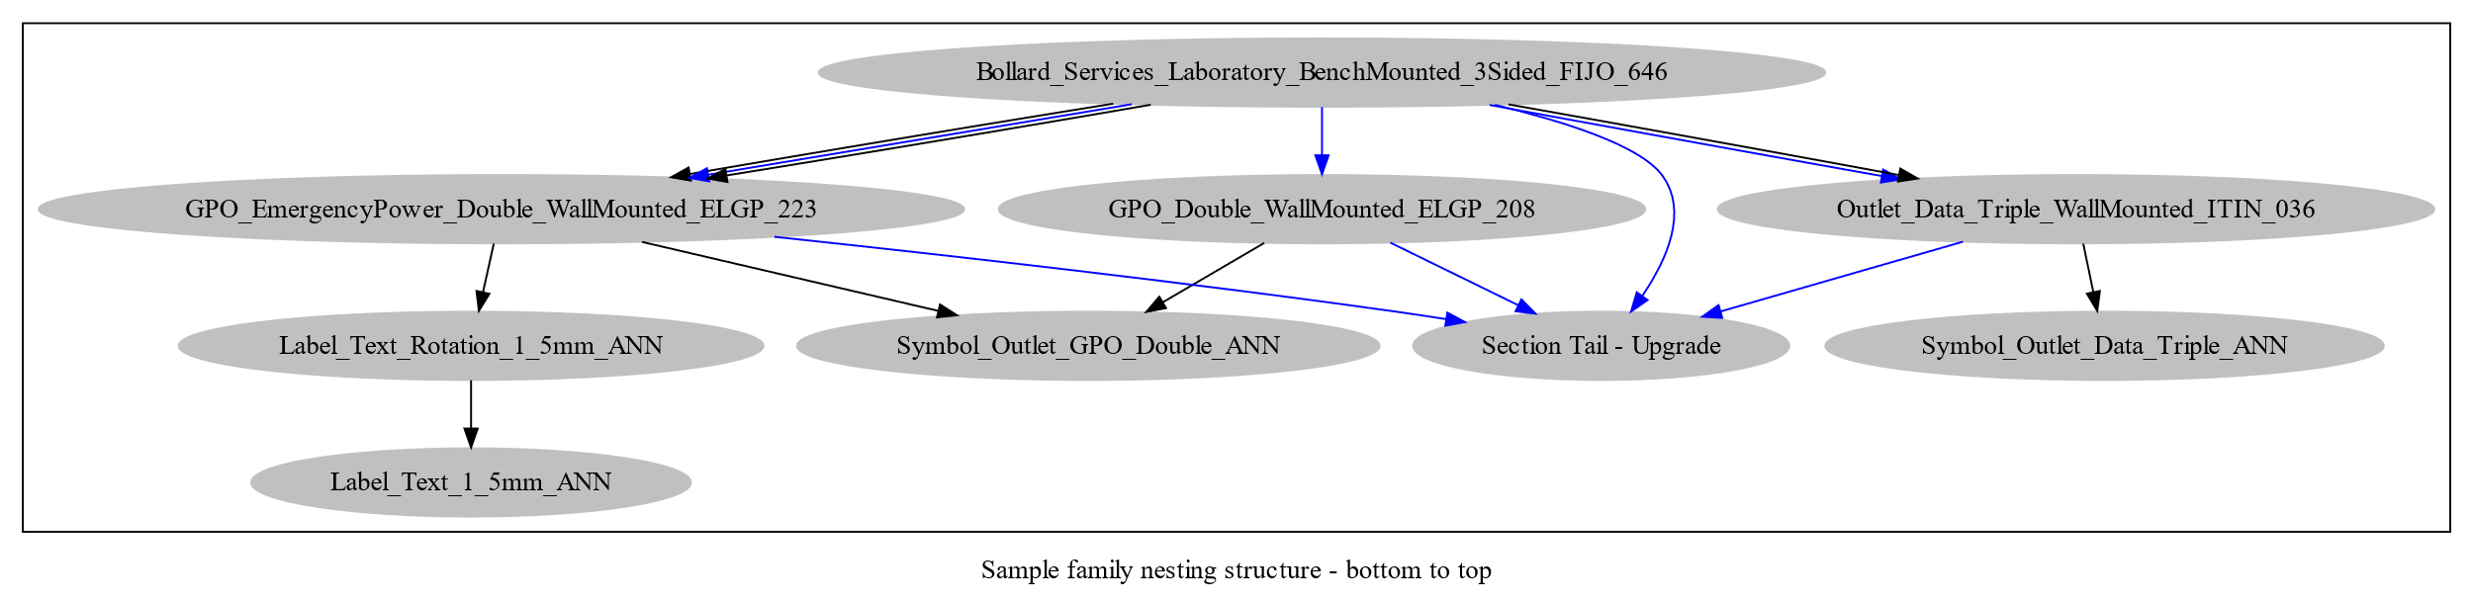
Reloading
Revit families use nesting to modularize components. As a result of this, any changes made to a nested family need to be ‘bubbled up’ from the bottom of the nesting tree to the top.

Slide 6
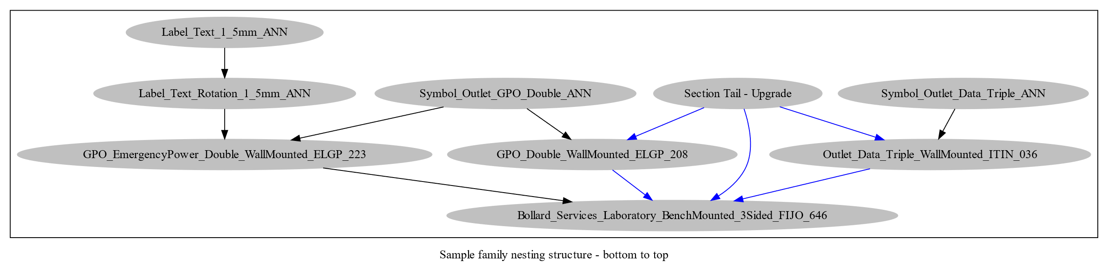
Reloading
Nested family structure from bottom up.

